Slide 1

ELECTRONICS 101
RESISTOR

Slide 2


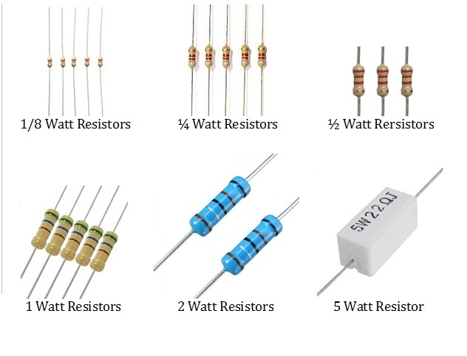
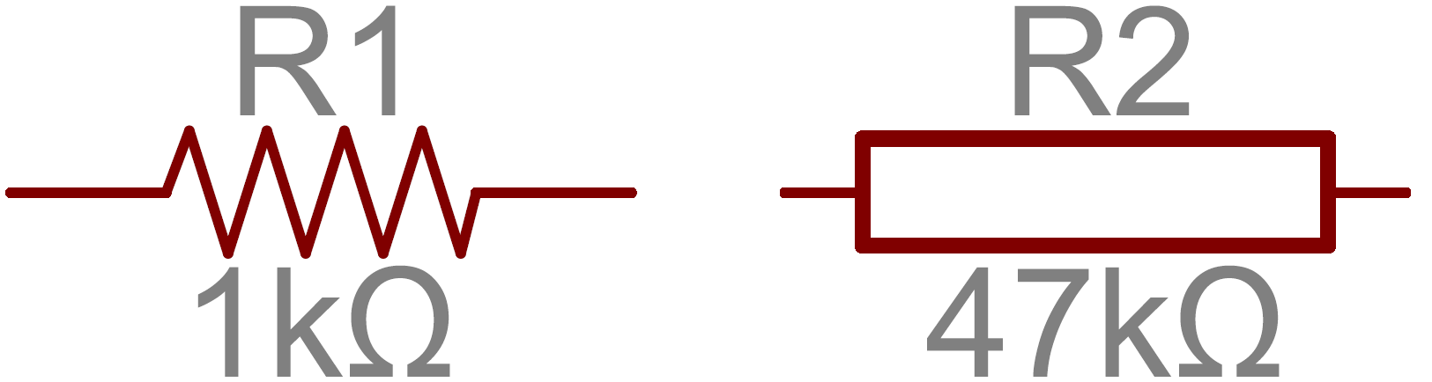
WHAT IS A RESISTOR?
An electronic component that resist the infinite current flow
Resistor reduces voltage
Converts electricity to heat
Comes in different power ratings
ex. ¼W, ½W, 1W, etc.
Ohms is the unit of measurement (Ω)
Most resistors are carbon film resistor
Symbols for resistor

Slide 3
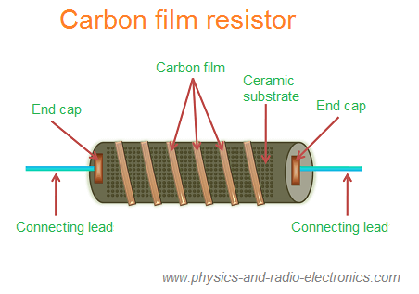
ANATOMY OF RESISTOR

Slide 4
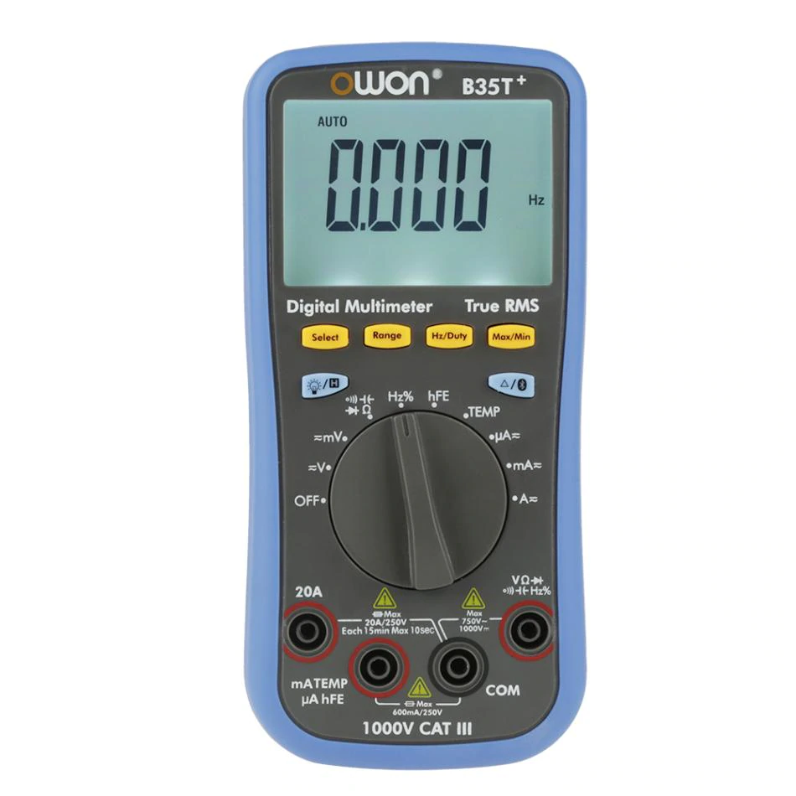
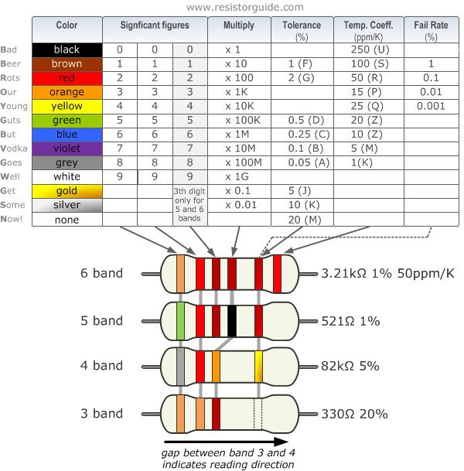
HOW TO TELL HOW MANY OHMS IN A RESISTOR?
OHM METER
COLOR BANDING

